Slide 1
HPC&MPI, Cloud&Virtualization
Understanding computing technology for research
Guido Marchetto

Slide 2
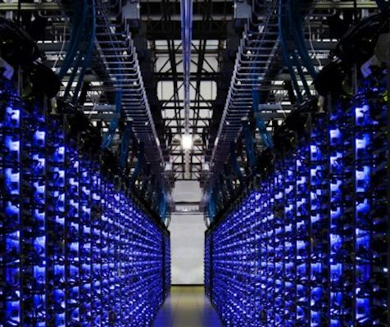
High Performance Computing
The term High Performance Computing (HPC) refers to a high power computing system based on a large number of computing nodes (cluster)

Slide 3
Motivation
Widespread need to manage complex problems that:
Require a large amount of computing power
Are highly parallelizable or use parallel software
Have a large amount of data to manage

Slide 4
Motivation
Widespread need to manage complex problems that:
Require a large amount of computing power
Are highly parallelizable or use parallel software
Have a large amount of data to manage

Slide 5
What is parallel computing?
Use of two or more processors in combination to solve a single problem
E.g.: a program to play chess might look at all the possible moves it could make in parallel
Single tasks can be distributed among different processors located on
A single node
A single Graphical Processing Unit (GPU)
Different nodes

Slide 6
How to write a parallel program
Open Multi-Processing (OpenMP)
Execution of parallel tasks on a single node
Compute Unified Device Architecture (CUDA)
Execution of parallel tasks on nVidia GPUs
Message Passing Interface (MPI)
Execution of parallel tasks on different nodes
Better with a high performance interconnection network (e.g., InfiniBand)

Slide 7
Do I need to know these libraries???
Yes, if you want to write your own program, but…
No, if you are using a program that supports parallel computing paradigms, e.g.:
StarCCM and Gromacs can exploit the MPI paradigm
Tensorflow supports parallel execution of (machine learning) parallel tasks on a single node, multiple nodes, and GPUs

Slide 8
HPC in applied science

Slide 9
HPC@Polito usage (1)

Slide 10
HPC@Polito usage (2)

Slide 11
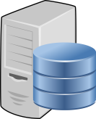
Cloud & Virtualization
Cloud Computing: elastic and on-demand provisioning of computing (and storage/networking)
Started in 2006 at Amazon
Mostly based on computing and storage virtualization
Virtualization: a flexible way to share hardware resources between different operating systems
Server 1
Server 2
Physical server
Virtual server 1
Virtual server 2
Virtual server 3
Server 3

Slide 12
Cloud@Polito
A new service available in our computing infrastructure
Provisioning of on-demand computing resources (IaaS)
E.g., I need a Linux machine with 4TB disk, 32GB RAM to work on my experiments, but just for 1 month…
Support for cloud-native application development
In general, a possible support for your own research, either cloud-specific or not

Slide 13
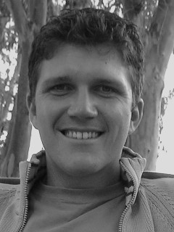
Guido Marchetto
guido.marchetto@polito.it

