Slide 1
Big Data - data science - machine learning: the solution to your problems
Marco Mellia

Slide 2
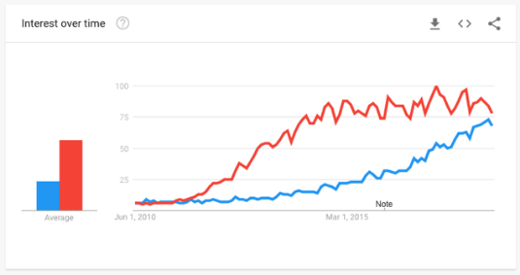
Big Data & Data Science & Machine Learning
“Extracting meaning from very large quantities of data”

Slide 3
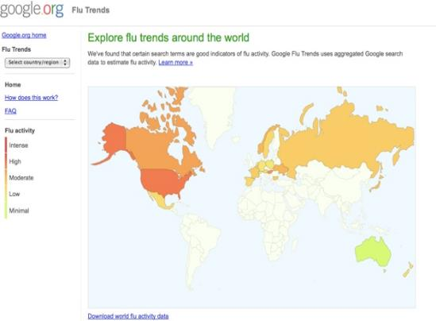
Google Flu trends
February 2010
Detected flu outbreak two weeks ahead of CDC data
Based on the analysis of Google search queries

Slide 4
The Vs of big data

Slide 5
The Vs of big data
Volume
Data volume increases exponentially over time
44x increase from 2009 to 2020
Digital data 47 ZB in 2020

Slide 6
Big Data today
You want:
Collect data
Store data
Process data
Extract value
You need a technology :
To collect (good) data
To store&process data
Methodologies and algorithms
A goal (!)

Slide 7
The bottleneck
Processors process data
Hard drives store data
We need to transfer data from the disk to the processor

Slide 8
The solution
Transfer the processing power to the data
Multiple distributed disks
Each one holding a portion of a large dataset
Process in parallel file portions from different disks

Slide 9
BigData vs HPC
HPC
Focus on CPU
Cores, RAM, GHz, GPU,…
Several jobs in parallel
Spread the computation
Message passing
PETAFLOPS
Move little amount of data to superfast CPUs
Big Data
Focus on storage
Disks, Fat Disks, and a bit of CPU and Network
MapReduce model
Divide and conquer approach
Simple operations on large amount of data
PETABYTES
Move code where data is

Slide 10
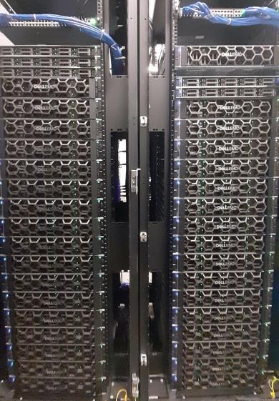
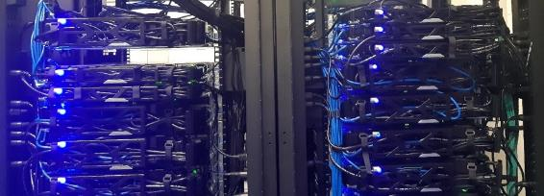
BigData@Polito – 2020 Expansion
40 new servers in 2 racks
New BigData@Polito cluster
1,400+ CPU cores + 4 GPUs (experimental)
15 TB of RAM memory
8 PB of raw disk storage
2,7 PB of net storage
50 Gb/s network
Over 50 GB/s throughput (expected)

Slide 11
Big Data - data science - machine learning the solution to your problems
Marco Mellia

Slide 12
Is this new?
https://hackerbits.com

Slide 13
Open issues
We are leaving in a data deluge epoch
Getting / storing / processing data is easier and easier
Extracting value from the data is THE challenge
Don’t blindly trust the magician – no Harry Potter stick here

Slide 14
Google Flu trends
February 2010
Detected flu outbreak two weeks ahead of CDC data
Based on the analysis of Google search queries
Discontinued!

Slide 15
Is it for free?
1 MW
30W

Slide 16
CLOUD TAG extracted
from participants’ keywords

Slide 17
Marco Mellia
mellia@polito.it

