Slide 1
HPC@POLITO
Our clusters and how the service works
Paolo Margara
paolo.margara@polito.it

Slide 2
Agenda
How the center is organized
Our HPC infrastructure
New users and usage trends
Future developments

Slide 3
Table of Contents
How the center is organized
Our HPC infrastructure
New users and usage trends
Future developments

Slide 4
HPC@POLITO Computing Center 1/2
Who we are?
HPC@POLITO provides calculation and technical support resources for academic research and teaching
What do we do?
The initiative offers to teachers, researchers, fellows and doctoral students the opportunity to use the center's calculation systems for projects that have great computational needs
An engineering service helps users to fully exploit the potential of clusters

Slide 5
HPC@POLITO Computing Center 2/2
How to get started?
The request for use can always be submitted
User data will be included on our site (http://hpc.polito.it) and on any reports
The user agrees to cite the center in his publications
Planned activities:
  Academic research
  Didactic courses
  Thesis activity
  Student teams
Clear rules and instructions:
  Center rules available online
  User manual available online in two languages

Slide 6
The history of HPC@POLITO
When was the HPC@POLITO service born?
First proof of concept in 2008
  CASPER
  CASPER2
In 2010 "The DAUIN HPC Initiative" was born
  CASPER3
In 2012, against the financing of the project by the BoG, the "The DAUIN HPC Initiative" service was renamed to "HPC@POLITO"
  2013: CASPER
  2015: HACTAR
  2019: LEGION

Slide 7
Table of Contents
How the center is organized
Our HPC infrastructure
New users and usage trends
Future developments

Slide 8
The CASPER cluster
Architecture | Linux Infiniband-DDR MIMD Distributed Shared-Memory Cluster
Node Interconnect | Infiniband DDR 20 Gb/s
Service Network | Gigabit Ethernet 1 Gb/s
CPU Model | 2x AMD Opteron 6276/6376 (Bulldozer) 2.3 GHz (turbo 3.0 GHz) 16 cores
Sustained performance | 4.360 TFLOPS (last update: 2014)
Peak performance | 5.658 TFLOPS (last update: 2014)
Computing Cores | 512
Number of Nodes | 16
Total RAM Memory | 2 TB DDR3 REGISTERED ECC
OS | Centos 7.4.1708 - OpenHPC 1.3.4
Scheduler | SLURM 17.11.5

Slide 9
The HACTAR cluster
Architecture | Linux Infiniband-QDR MIMD Distributed Shared-Memory Cluster
Node Interconnect | Infiniband QDR 40 Gb/s
Service Network | Gigabit Ethernet 1 Gb/s
CPU Model | 2x Intel Xeon E5-2680 v3 2.50 GHz (turbo 3.3 GHz) 12 cores
GPU Model | 2x nVidia Tesla K40 12 GB 2880 cores (on 1 nodes)
Sustained performance | 20.13 TFLOPS (last update: june 2018)
Peak performance | 25.61 TFLOPS (last update: june 2018)
Computing Cores | 696
Number of Nodes | 29
Total RAM Memory | 3.6 TB DDR4 REGISTERED ECC
OS | Centos 7.4.1708 - OpenHPC 1.3.4
Scheduler | SLURM 17.11.5

Slide 10
The LEGION cluster
Architecture | Linux Infiniband-QDR MIMD Distributed Shared-Memory Cluster
Node Interconnect | Infiniband EDR 100 Gb/s
Service Network | Gigabit Ethernet 1 Gb/s
CPU Model | 2x Intel Xeon Scalable Processors Gold 6130 2.10 GHz 16 cores
GPU Model | 8x nVidia Tesla V100 SXM2 - 32 GB - 5120 cuda cores (on 2 nodes)
Sustained performance | 21.094 TFLOPS (last update: july 2019)
Peak performance | 27.238 TFLOPS (last update: july 2019)
Computing Cores | 448
Number of Nodes | 14
Total RAM Memory | 5.376 TB DDR4 REGISTERED ECC
OS | Centos 7.6.1810 - OpenHPC 1.3.8.1
Scheduler | SLURM 18.08.8

Slide 11
The STORAGE serving clusters
Home storage
Architecture | Traditional NAS with NFS share
Space | 141TB
Throughput | near 200 MB/s
Clusters Interconnect | 10Gb/s Ethernet
High performance storage
Architecture | Parallel Lustre file system with HA
Space | 87TB
CASPER Throughput | near 1.10 GB/s
CASPER Interconnect | 10Gb/s Ethernet
HACTAR Throughput | near 2.20 GB/s
HACTAR Interconnect | 40Gb/s Infiniband QDR

Slide 12
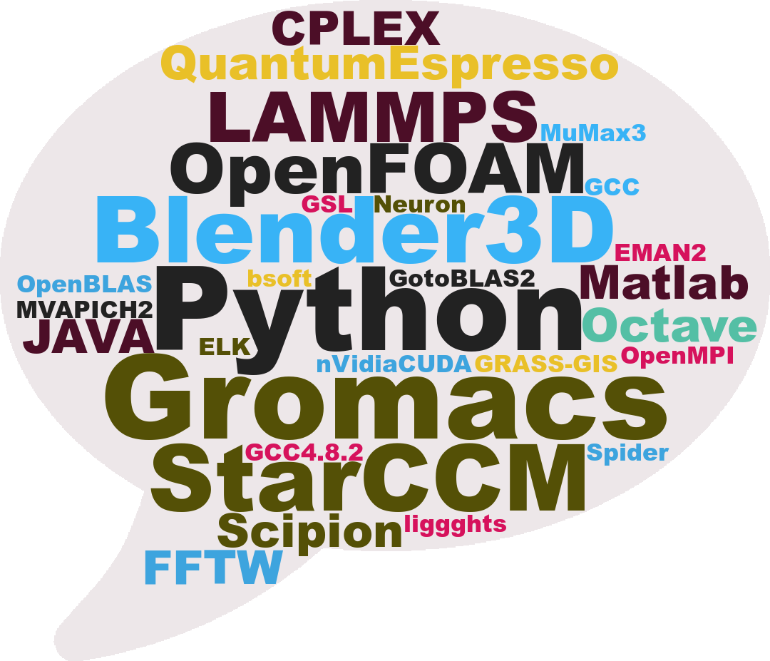
Some available software

Slide 13
HPC for Machine Learning, Deep Learning and Artificial Intelligence
Excellent integration with widely used frameworks (e.g.: tensorflow)
Optimized Python distributions (e.g.: Intel Python)
Wide availability of optimized libraries for CPU and GPU
Available accelerator cards:
  nVidia Tesla K40 12GB on HACTAR cluster
  nVidia Tesla V100 32GB on LEGION cluster
Possibility to exploit the Infiniband network
Reproducibility of the working environment:
  Python virtualenv
  Singularity containers

Slide 14
Table of Contents
How the center is organized
Our HPC infrastructure
New users and usage trends
Future developments

Slide 15
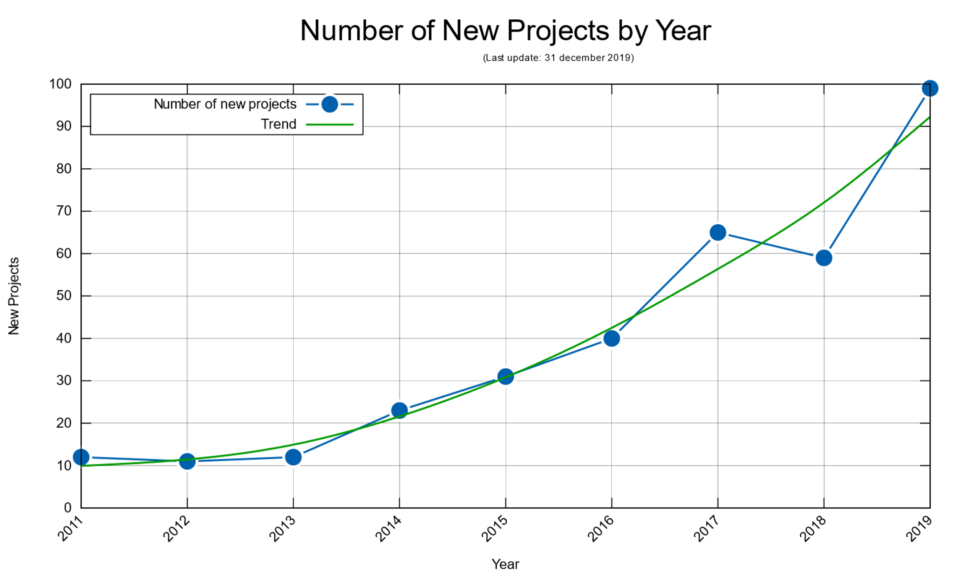

Slide 16
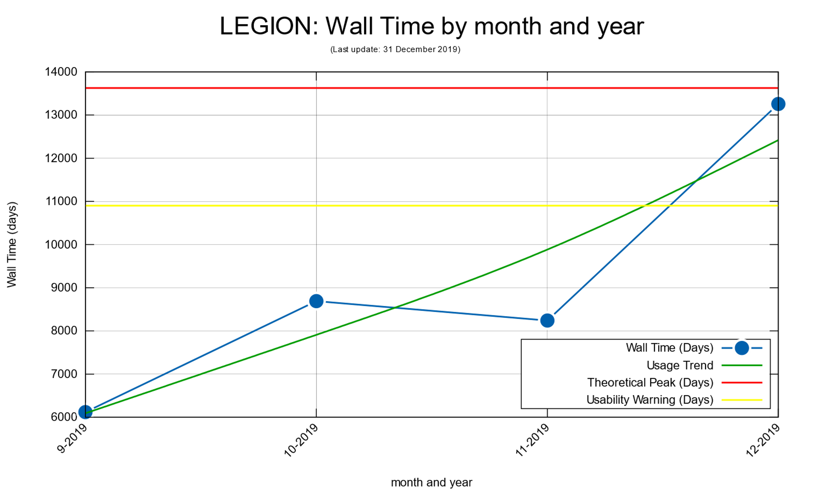

Slide 17
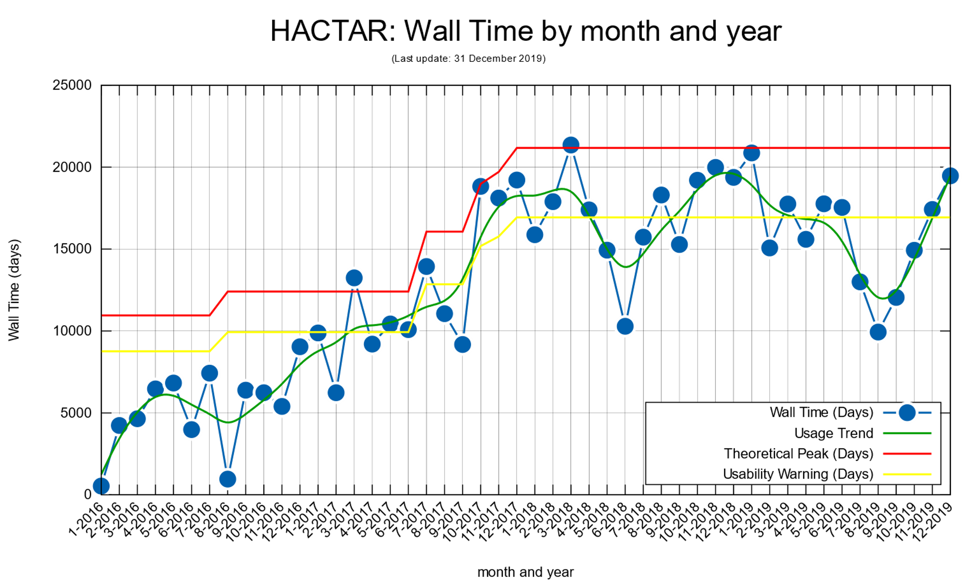

Slide 18
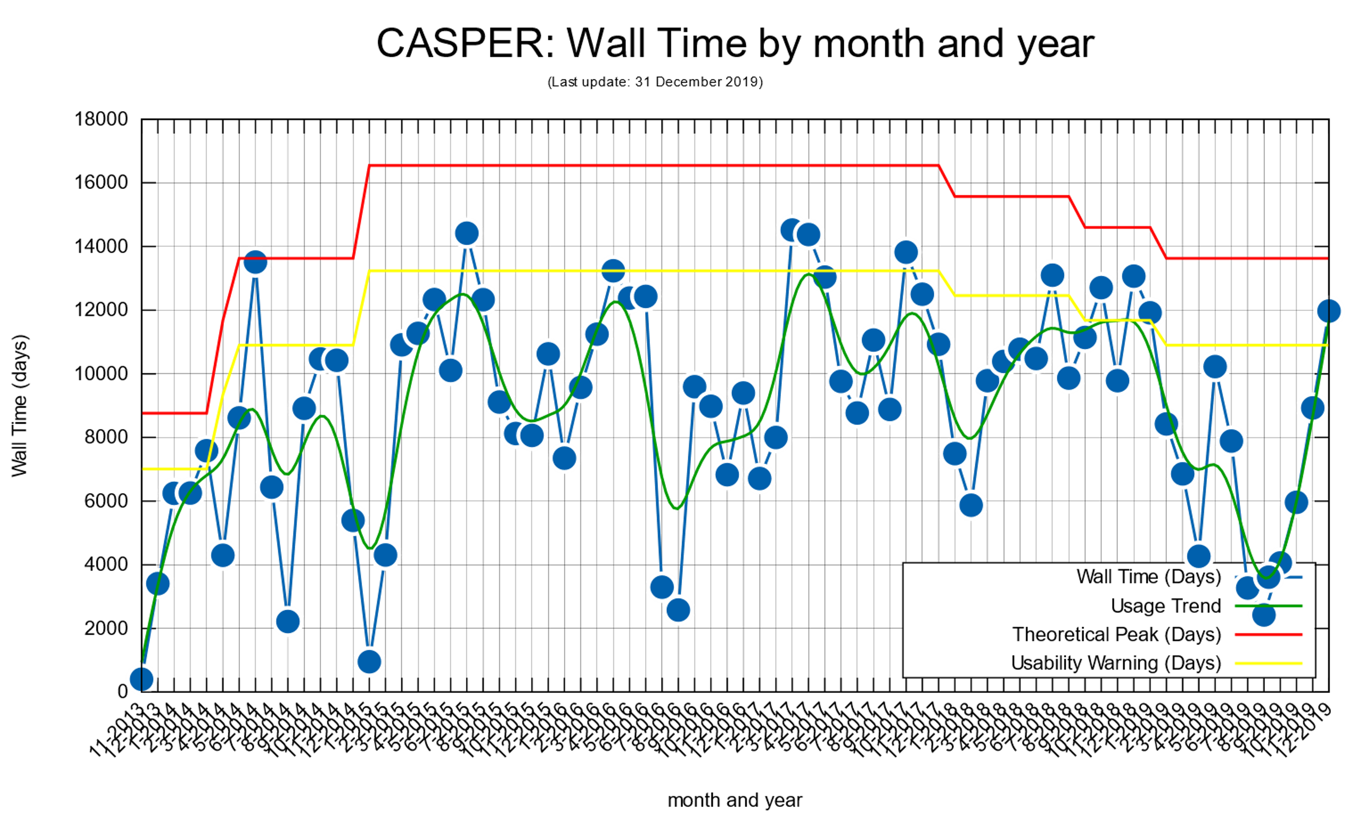

Slide 19
Table of Contents
How the center is organized
Our HPC infrastructure
New users and usage trends
Future developments

Slide 20
Hardware upgrades
Finalizing the installation of the 2nd trance of nodes on LEGION
  40 new CPU nodes
  4 new GPU nodes
  2 new racks for future expansions
New high performance storage
  At least 256 TB with buddy group
  Will replace home and work storage systems
Which future for CASPER?
  Will be dismissed or merged into HACTAR?

Slide 21
New software features
Periodic cluster updates
  CentOS 7.7 & OpenHPC 1.3.9
Improving Singularity containers support
  Local container registry with applications packaged by the Staff
Cloud bursting support
  Ability to use the public cloud for work peaks management

Slide 22
Thank you for your attention
hpc.dauin@polito.it
hpc@polito.it

