Slide 1
BigData@Polito
Scalable Big Data Processing for Research
Idilio Drago

Slide 2
BigData@Polito Brief History
1st BigDataLab Cluster
Joint activity supported by DET, DAUIN, DISMA, DIGEP
Prototype built in 2014, on-line since 2015
Used both for research and didactics
Master’s Courses on big data technologies and analytics
Up to 300 students per year
SmartData@PoliTO Center started on 2018
Key infrastructure supporting researchers at the Center
BigData@Polito Cluster expanded thanks HPC4AI (2020)

Slide 3
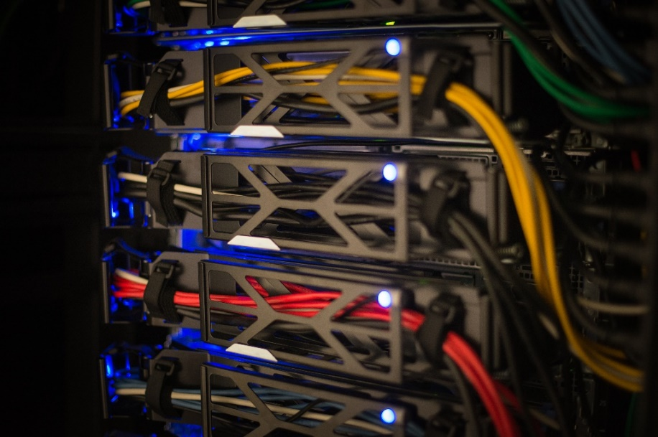
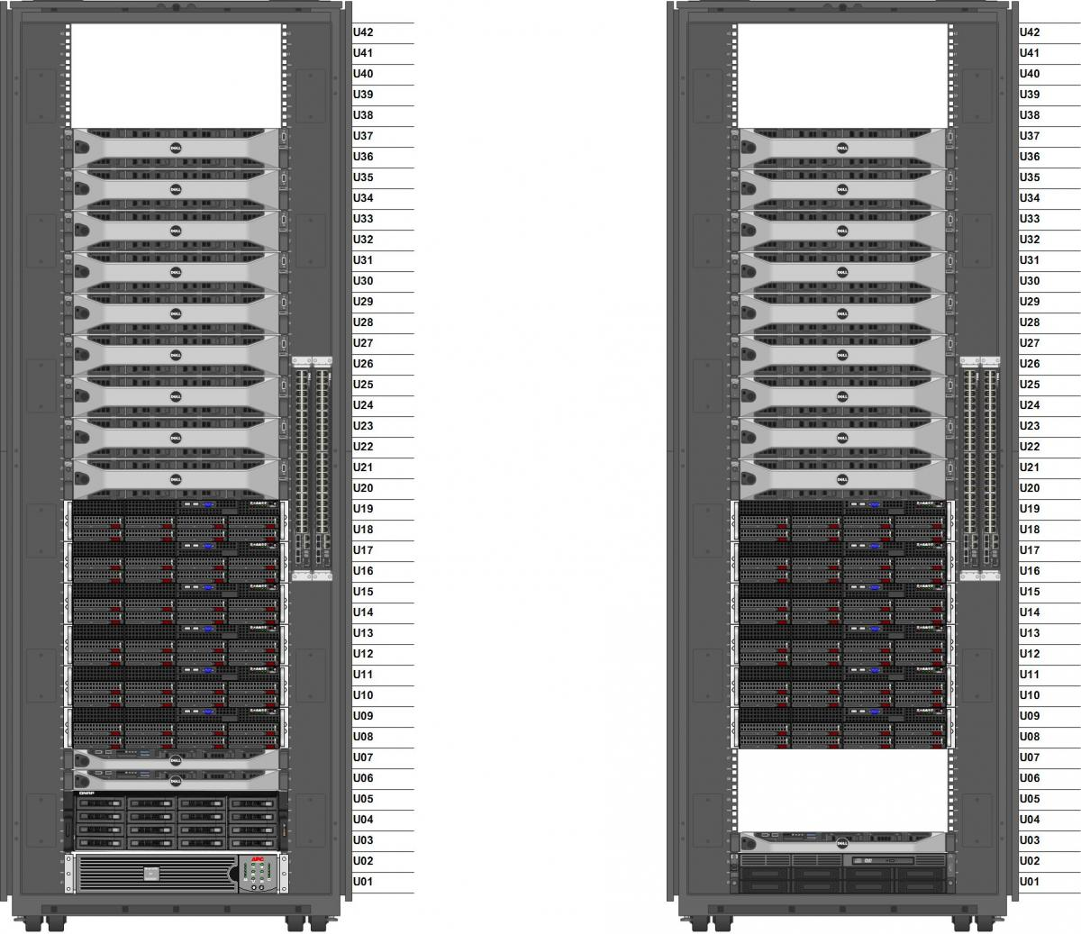
BigData@Polito – First Cluster
2 racks “exposed” on Aule-T
33 servers
18+12 Workers (2 generations)
3 Masters modes
768 TB of raw disk space
220 TB of net storage offered to users

Slide 4
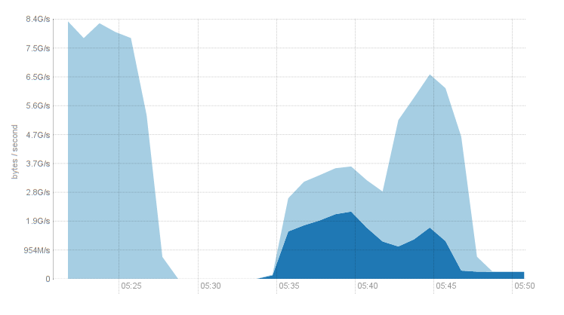
BigData@Polito – First Cluster
Data locality → data reading and processing directly on working nodes
~12 GB/s raw read throughput
Peak 8 GB/s peak throughput (“terasort” benchmarks)

Slide 5
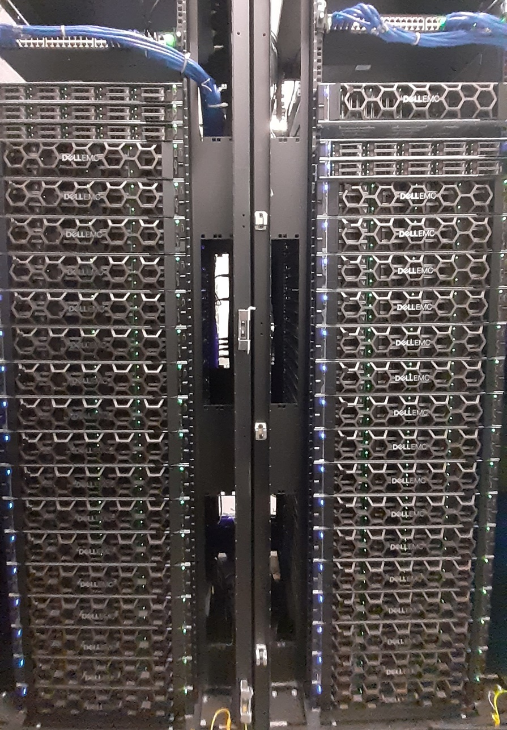
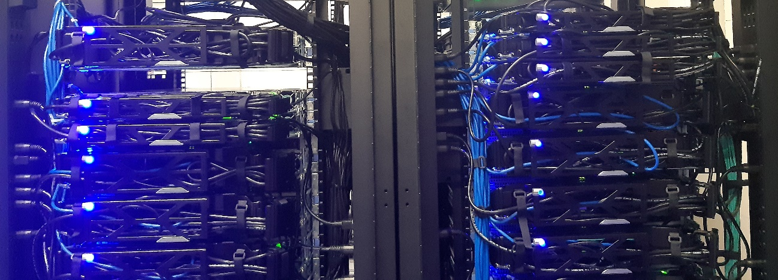
BigData@Polito – 2020 Expansion
40 new servers in 2 racks
New BigData@Polito cluster
1,400+ CPU cores + 4 GPUs (experimental)
15 TB of RAM memory
8 PB of raw disk storage
2,7 PB of net storage
50 Gb/s network
Over 50 GB/s throughput (expected)

Slide 6
What can be done with this cluster?
We rely on platforms specialized on big data analytics
Batch processing using Hadoop ecosystem
HDFS, Yarn, MapReduce, Spark, Impala, Kafka etc.
JupyterLab as user interface and interactive analytics platform
Python and Java (most used), support also R, Scala etc.

Slide 7
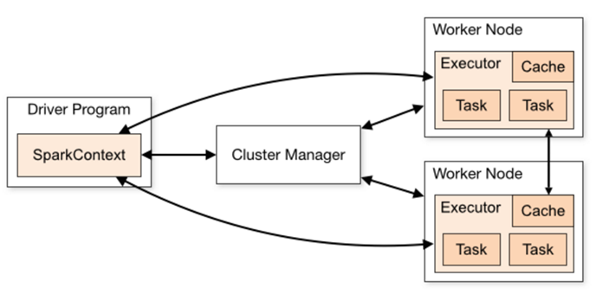
How does it work?
Gateway
Interact with the File System
Interactive development
Fires the “driver”

Slide 8
How does it work?
Gateway
Interact with the File System
Interactive development
Fires the “driver”
Workers
Parallel processing (“big data”)

Slide 9
How does it work?
Gateway
Interact with the File System
Interactive development
Fires the “driver”
Workers
Parallel processing (“big data”)
Gateway
Final processing (“small data”)
Interactive analytics
Visualization

Slide 10
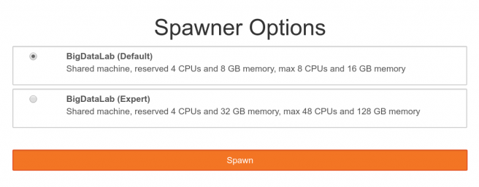
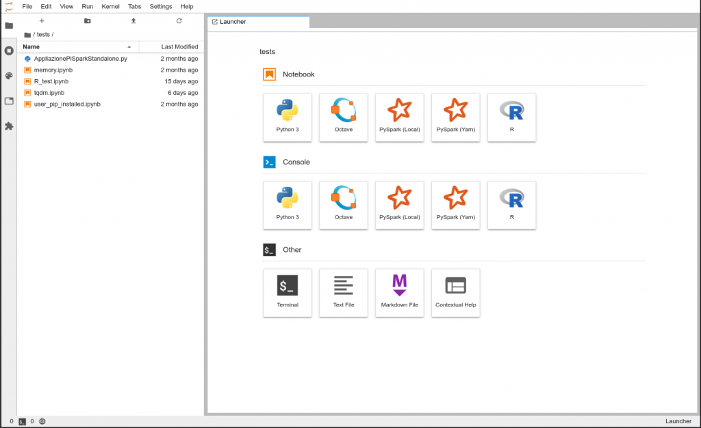
How does it work?
Web-based access
Spawn a container image
Terminal, iPython, Notebooks...
Pre-built images w/different resources
Fixed resource budget vs. Timeouts
Larger images, shorter timeouts
Spark
Fair share with preemption
Priorities: “sponsors”, projects, courses ...

Slide 11
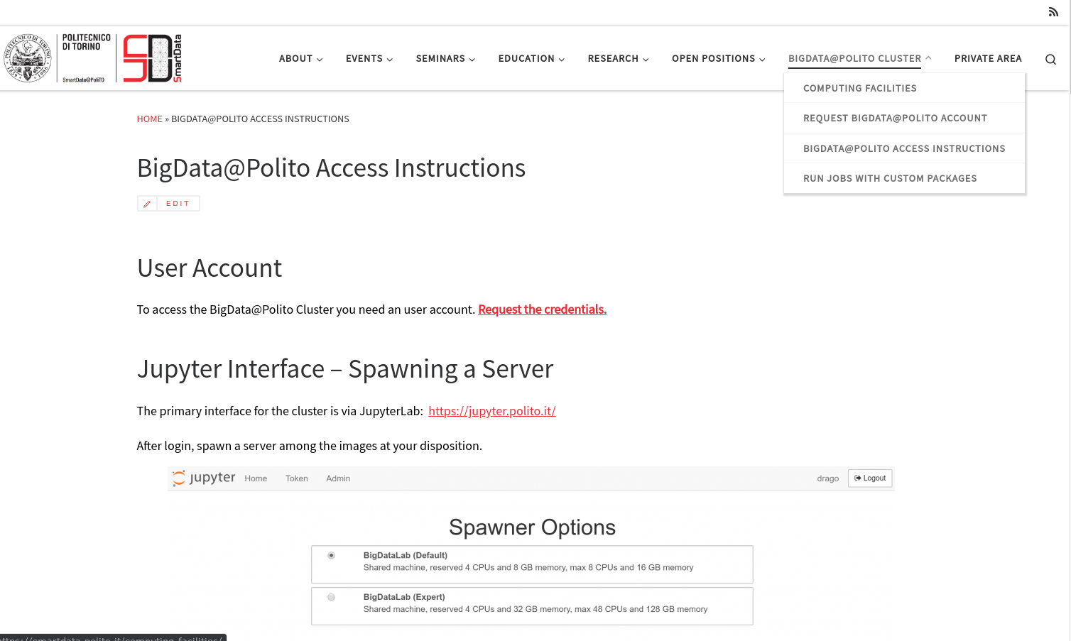
How to get access and support?
https://smartdata.polito.it/

Slide 12
Idilio Drago
idilio.drago@polito.it

