Slide 1
Cloud@Polito
Cloud Computing Facilities for Research
January 17th 2020
Enrico Venuto
Head of IT Infrastructure Service
Politecnico di Torino

Slide 2
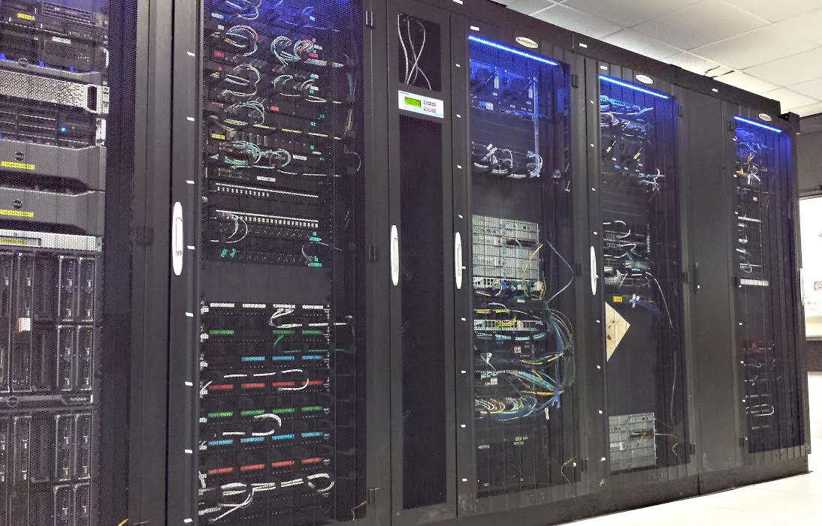
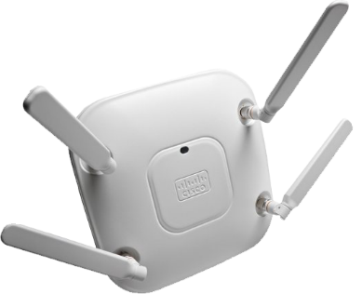
Politecnico IT Infrastructure
Capacity
Internet Connection (via GARR) = 2 x 10 Gbps FD
480 Gbps core aggregated bandwidth
Up to 160 Gbps departements aggregated bandwidth
Datacenter
2 main datacenters in Business Continuity
3 switching rooms
Many technical rooms
~250 Network Rack
Networking devices
Access Points: ~700
Switches & routers: ~500
Networked devices
Telephones: ~3.400
Network nodes: ~16,000
Thousands of mobile devices

Slide 3
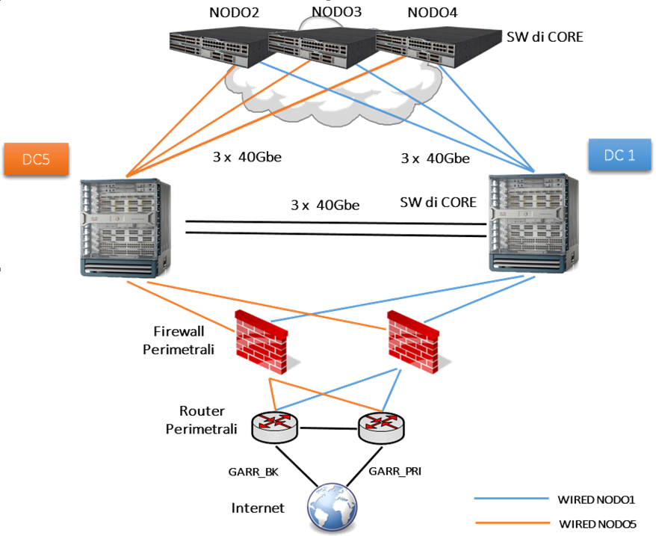
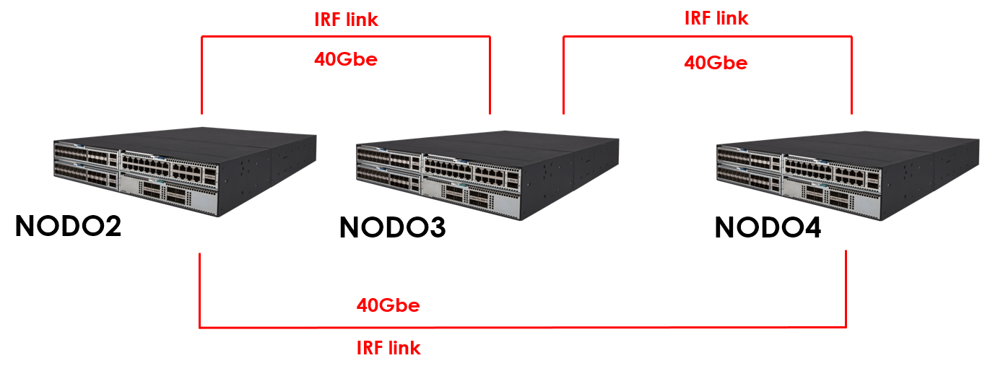
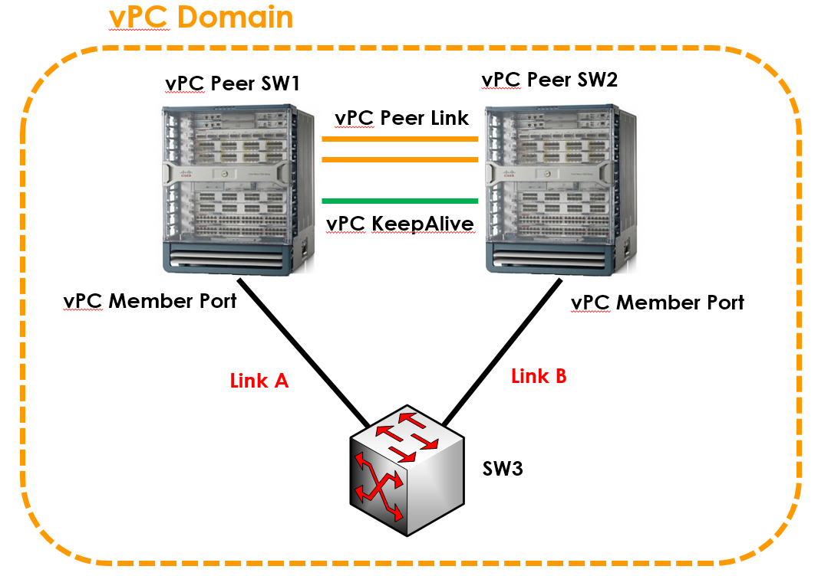
Networking
Dipartimento di Automatica e Informatica
HPE 5900 in IRF
Cisco Nexus 7000 vPC
Cisco Catalyst 4500 in VSS
10 GbE GARR Secondary
10 GbE GARR Primary

Slide 4
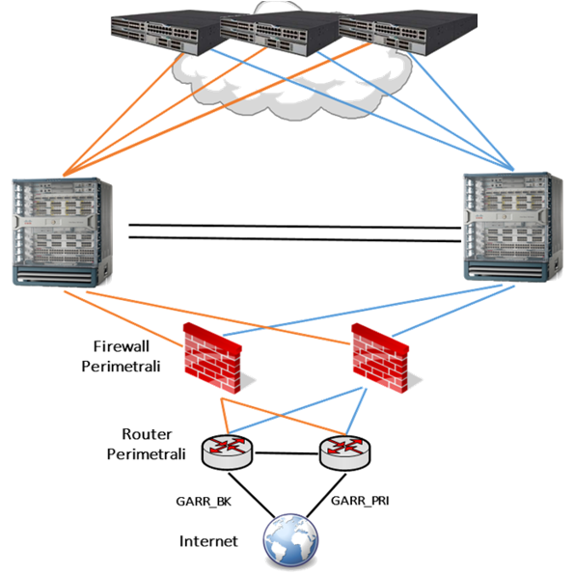



Where’s Computing@PoliTO
Dipartimento di Automatica e Informatica
Dipartimento C
Dipartimento D
Dipartimento B
Departiment A
Dipartimento i-esimo
DATACENTER 1
DATACENTER 5

Slide 5
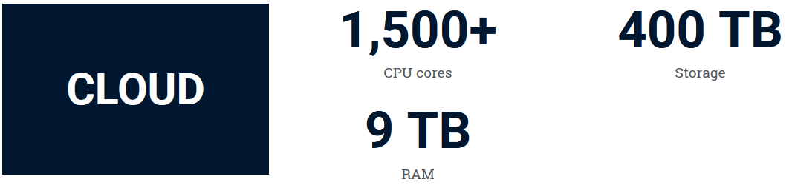
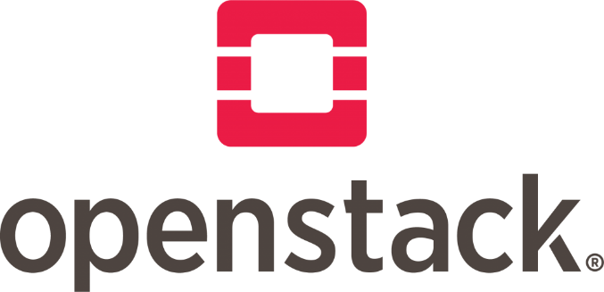


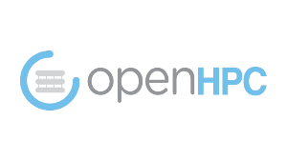
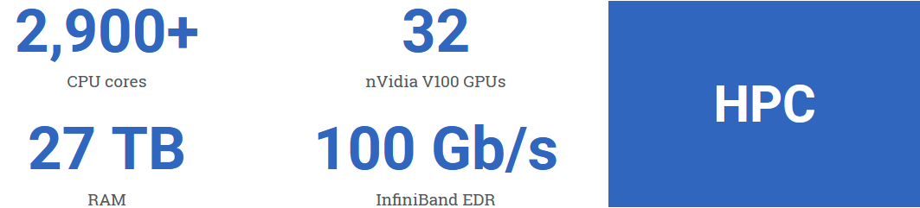

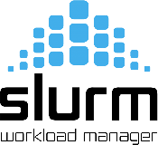
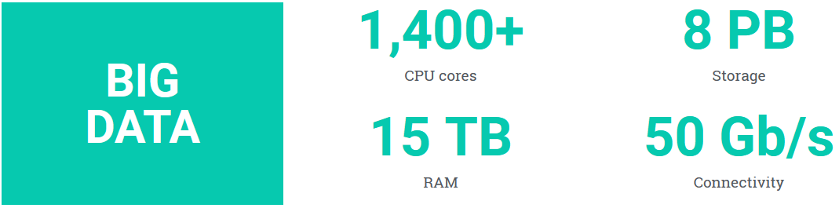




Computing@PoliTO

Slide 6
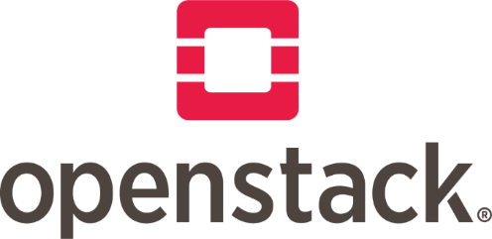
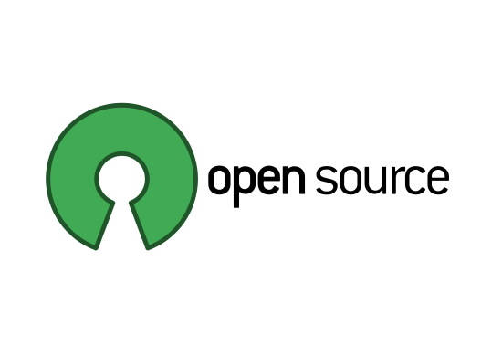
Cloud@PoliTO
Private Cloud Computing System based on OpenStack: Open source software for public and private Cloud by Rackspace Cloud and NASA.
Come from Politecnico di Torino Information Technology Area and SmartData@PoliTO and HPC@POLITO, in collaboration with the GARR.
One of the first entering in the GARR Consortium Cloud Federation.

Slide 7

Cloud@PoliTO
IaaS Private Cloud
Self-service virtualization system
A place for research and for Native Cloud APP development
Federated: research and experimentation on replica and delocalization of data and services on the Research Italian Cloud: a place for cooperation

Slide 8


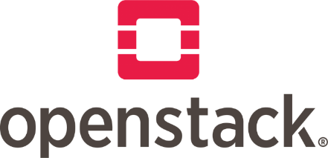
Why Cloud@PoliTO
High bandwidth
Low latecncy
Regions with well known network connections and routing
Federated Identities to authenticate all the researchers and the students from all the Universities and Research Agencies in Italy, Europe (and large part of the world)
Low $$$ operating VM on-premise
…the ability to work in Cloud in your Datacenter

Slide 9
Cloud in your Datacenter
Data Sovranity:
possibility of exercising sovereignty, of guaranteeing control over your data, from storage, indexing, extraction / storage to processing and communication.
Operational Capacity:
Possibility for the University to act in the field of research and on projects financed from the outside (government agencies, industries, ...) through confidential, certified and certifiable Data Management Plan. Often it is necessary to know where the data and metadata are, who has access and who administer (also in the sense of specifying names) and to be able to declare it.
Know-How:
Availability, within the University, of a wealth of knowledge and technical skills, capable of managing and developing advanced IT infrastructures that support research.

Slide 10
Legal Trends
National Cyber-Security Border - Perimetro di Sicurezza Cibernetica nazionale (Italia 9/19/19)
Clarifyng Lawfull Overseas Use of Data Act (CLOUD Act) (USA 3/23/18)- allows federal law enforcement to compel U.S.-based technology companies to provide requested data stored on servers regardless of whether the data are stored in the U.S. or on foreign soil.
中华人民共和国网络安全法
(Cybersecurity Law of the People’s Republic of China) (Cina 11/7/16) - companies that operate a network must tell the government how sensitive the data they handle is, and what strategies they use to protect it; inspectors can plug directly into their networks for verifying.
Gaia-X (Germany 10/29/19): German Economy Minister presented the European data infrastructure as an alternative to services of American Internet giants.

Slide 11
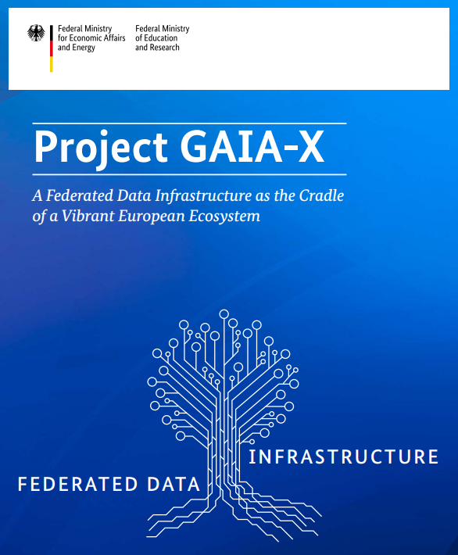
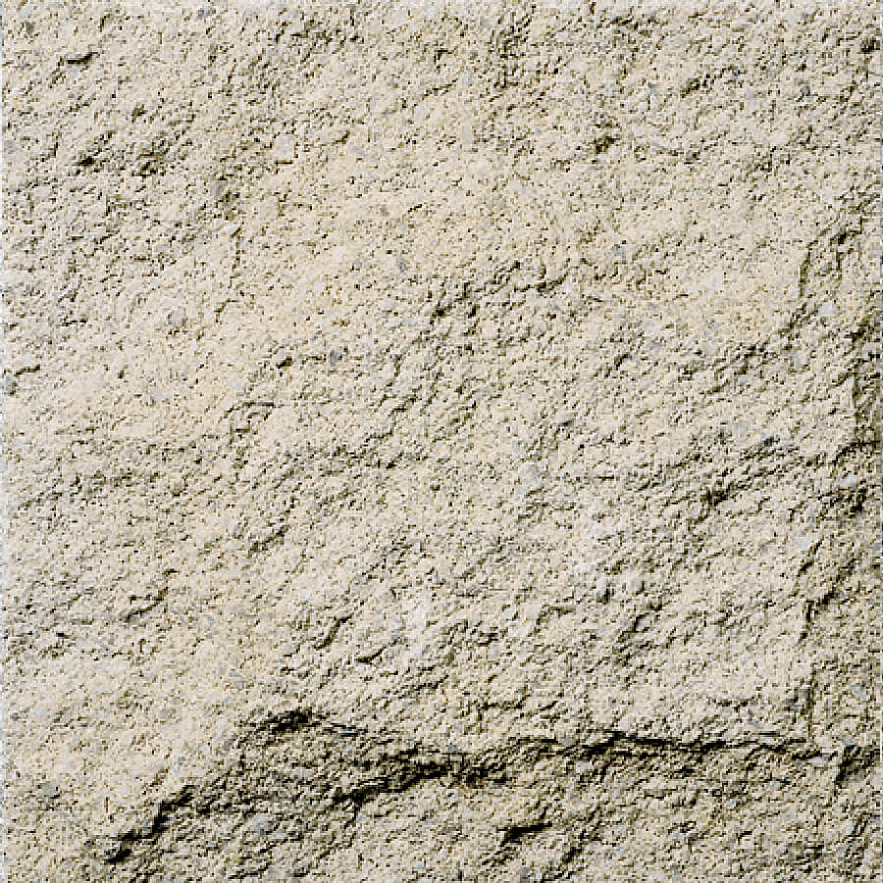

Data will be the most
important raw material of
the future
Peter Altmaier – German Economy Minister
The European economy urgently needs an infrastructure that ensures data sovereignty […] platforms where the potential of A.I. can be tapped while privacy is safeguarded, all without reliance on foreign services.
Peter Altmaier – German Economy Minister

Slide 12
Case Study: Backup replica
GARR Cloud Federation for experimenting the replica of our backup in the Palermo Openstack Federated Region using both CommVault and Veeam.
  Daily replica of 60 TB of native data
  Total space used: 25 TB
  6 months retention
  Encrypted data with very high de-duplication level
  Started: end 2018 – Still working

Slide 13
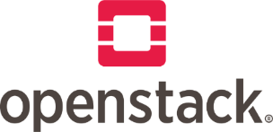

Slide 14
Case Study: VM replica
Second Step:
Cross-Platform Replica of some virtual machines using backup system features on different Openstack federated regions.
Starting mid 2020
Third Step:
Cross-Platform Live Sync Replication: incremental replication from a backup of a virtual machine to a synced copy of the virtual machine on different Openstack federated regions
Compatibility matrix analisys running

Slide 15


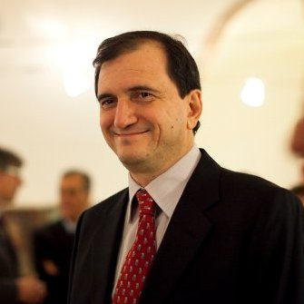

Enrico Venuto
venuto@polito.it

