Slide 1
Opportunities for collaborations & industrial project support
Marco Mellia

Slide 2
What we can do for you
Computing@PoliTO is a new service that we are promoting
After ±10 years of HPC@PoliTO and ±5 years of BigData@PoliTO, merge into a single service for research
HPC
Big Data
Cloud
Open for collaborations and research
Computing@POLITO

Slide 3
Access schemes to computing resources
Basic access
Premium access
Hardware sponsoring

Slide 4
Basic access
Basic access
Everyone can access to the computing resources
You get a login/pwd, and (limited) support
You can submit jobs, run analytics, store&process data, …
Only on the free resources in the clusters
Remember – it is a shared infrastructure – respect rules
Sessions will expire
Memory is expensive
No interactive usage (batch processing – for everyone)

Slide 5
Premium access
Warning: No accounting for funded projects
Premium access
You buy privileged access to resources – for limited time
Come to talk to us for details/prices
When you are using it – it would be reserved for you
When you are not using it – it would be shared for basic access use
Remember – it is still a shared infrastructure – respect rules
You should expire sessions and free resource when not using it
Still no interactive usage (batch processing – for everyone)
Money is used to maintain and grow the infrastructure and people working (also for you)

Slide 6
Hosting of resource
Possible accounting for funded projects
Hardware hosting
A policy in place with HPC and very efficient
We
Buy HW for/with you [twice a year – we’ll advertise the call]
Configure/optimize/maintain/update the HW and SW for you
We deal with CONSIP/MEPA/SDAPA/AGID/YNI regulations
You
Provide money to buy HW and get an invoice if needed
Get premium access to “your” slice of HW
Save money and (lot of) time
Subject to
We decide the HW and SW configuration
”I need to run this software on windows XP on a 384GB of mem PC”
“I’d like you to install and manage this GPU I bought on amazon for 200bucks”

Slide 7
Example of hosting
2 | PowerEdge C4140 Server | € 85.277,95 | € 170.555,90 | € 57.989,01
1 | PowerEdge R740 Server | € 53.240,97 | € 53.240,97 | € 18.101,93
5 | PowerEdge R640 Server | € 22.892,95 | € 114.464,75 | € 38.918,02
1 | Dell Networking S3048-ON 48x 1GbE 4x SFP+ 10GbE ports Stacking IO to PSU air 1x AC PSU DNOS 9 | € 15.875,00 | € 15.875,00 | € 5.397,50
1 | Dell Networking Z9100-ON 32x QSFP28 and 2x SFP+ fixed ports PSU to IO airflow 2x AC PSUs Dell Networking OS9 | € 59.358,00 | € 59.358,00 | € 20.181,72
34 | PowerEdge R740XD Server | € 41.589,94 | € 1.414.057,96 | € 480.779,71
 |  |  | € 1.860.912,36 | € 645.910,20
±66% discount
(Better than Consip)

Slide 8
Example of services
“I’d like to try deep learning on some GPU. Can you help?” → Basic access / Premium access
“I’ve a project where I need to buy a cluster for big data. Which HW/SW shall I use?” → Hardware hosting
”I’d like to contribute to the HPC since it helped so much for my research. How can I ?” → Free donation ☺
“I need to run this supercool software which requires a large dedicated machines – but I would need it for 4 months only – and I need it now”→ Premium access

Slide 9
Collaboration with industries

Slide 10
Computing@PoliTO for PoliTO
HPC4AI is a Infra-P project
Phase-1: Regione Piemonte co-funded project for 1.5ME to build a ”open research infrastructure”
Phase-2: open to collaborations with industries
Open call running now – “Bando VIR” – Voucher Infrastutture di Ricerca
Rationale: support piedmont SME to get access to top-level qualified research infrastructures

Slide 11
Details of the VIR call
Continuously open call – from 29/7/2019 up to 31/12/2020
19MEuros (15ME still available!)
70% co-funding from Regione Piemonte
The company puts 30% of the cost
Reserved for SME (<250 employees & < 50ME turnover)
In Piedmont
Minimum contribution: 20kE (28.5kE total costs)
Maximum contribution: 200kE (285kE total costs)

Slide 12
Why this is interesting?
HPC4AI is a “qualified top-level research infrastructure”
It is possible to participate to the VIR call and get 70% contribution
Example:
You have a collaboration with an SME
You use/design {BD|AI |cloud} computing solutions for the project
The SME asks for contribution through the VIR call
You give HPC4AI the equivalent cost for the {HPC|BD|Cloud} resources
See computing.polito.it for details
There you find “example” of collaborations and costs
Come to talk to us if interested

Slide 13
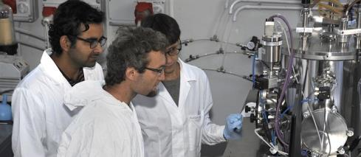
How to use the VIR
Regione Piemonte refunds the SME with 70% of the costs
SME signs a research contract with a Department
Department executes it and provides an invoice – through regular third party contracts
SME has a resarch project
The department internally transfers a part of the costs to the HPC4AI for the Computing resources

Slide 14
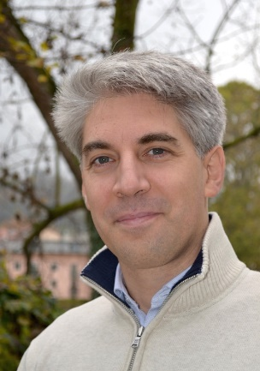
Marco Mellia
mellia@polito.it

