Slide 1
Artificial Intelligence and big data… in practice
ELENA BARALIS
Politecnico di Torino

Slide 2
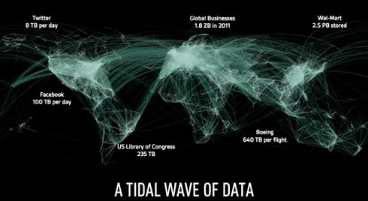
Big data is here
Volume
Data volume increases exponentially over time
Velocity
Variety
Veracity
… Value

Slide 3
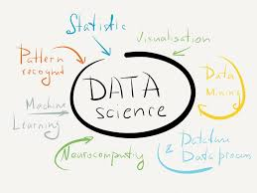
Data science
“Extracting meaning from very large quantities of data”
D.J. Patil coined the word data scientist

Slide 4
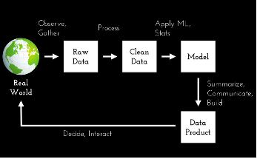
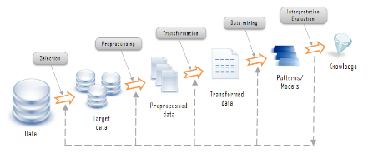
The data science process
Generation
Acquisition
Storage
Analysis
AKA KDD process
Knowledge Discovery in Databases

Slide 5
Analysis
Objectives
Descriptive analytics
Predictive analytics
Prescriptive analytics
Methods
Statistical analysis, data mining, text mining, network and graph data mining
Association analysis, classification and regression, clustering
Diverse domains call for customized techniques
Generation
Acquisition
Storage
Analysis

Slide 6
Association rules
Objective
extraction of frequent correlations or pattern from a transactional database
Tickets at a supermarket counter
TID | Items
1 | Bread, Coke, Milk
2 | Beer, Bread
3 | Beer, Coke, Diapers, Milk
4 | Beer, Bread, Diapers, Milk
5 | Coke, Diapers, Milk
… | …
Association rule
diapers ⇒ beer
2% of transactions contains both items
30% of transactions containing diapers also contain beer

Slide 7
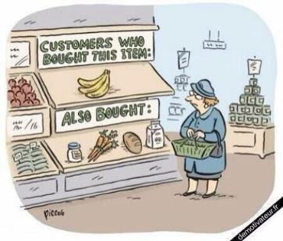
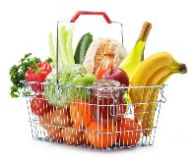
Association rules

Slide 8
Classification
Objectives
prediction of a class label
definition of an interpretable model of a given phenomenon
training data
model
unclassified data
classified data

Slide 9
Classification

Slide 10
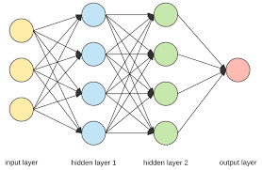
Classification techniques
Decision trees
Classification rules
Association rules
Neural Networks
Naïve Bayes and Bayesian Networks
k-Nearest Neighbours (k-NN)
Support Vector Machines (SVM)
…

Slide 11
Clustering
Objectives
detecting groups of similar data objects
identifying exceptions and outliers

Slide 12
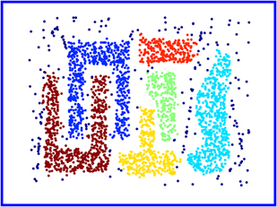
Clustering
Objectives
detecting groups of similar data objects
identifying exceptions and outliers

Slide 13
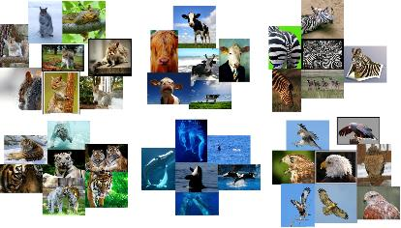
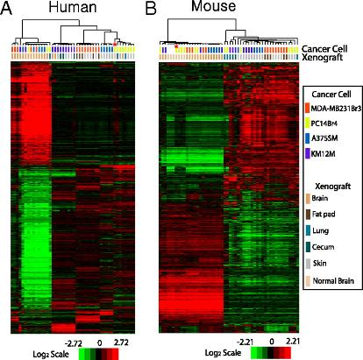
Clustering
Notes:
Gene expression patterns of xenografted tissues. (A) Hierarchical clustering analysis of gene expression data from human microarray experiments with xenografted tumors. Genes with expression variance within the 25th percentile and having at least a 1.5-fold difference in at least 20% of samples relative to the median value across all samples were selected for clustering analysis (11,156 gene features). The data are presented in matrix format, in which rows represent individual genes and columns represent each tissue. Each cell in the matrix represents the expression level of a gene feature in an individual tissue. The color red or green in cells reflects relative high or low expression levels, respectively, which is indicated in the scale bar (log2-transformed scale). To test the influence of mouse RNA during hybridization, mouse brain RNAs were mixed with the RNAs from PC14Br cells in cell culture before microarray experiments (highlighted with asterisk). (B) Hierarchical clustering analysis of gene expression data from mouse microarray experiments with the same xenografted tumor tissues used in human microarray experiments. Expression data of 10,160 gene features were used for this analysis after applying variance filtration. Gene expression data generated with mixed RNA were also highlighted. The first and second letters of the sample identification code in the dendrogram represent cancer cell lines and xenografted organ sites, respectively. A, A375SM; K, KM12M; M, MDA-MB231Br3; P, PC14Br4 for cell lines. B, brain; C, cecum; F, fat pad; L, lung; S, skin for organ sites.

Slide 14
Notion of a Cluster can be Ambiguous
How many clusters?
Six Clusters
Two Clusters
Four Clusters
From: Tan,Steinbach, Kumar, Introduction to Data Mining, McGraw Hill 2006

Slide 15
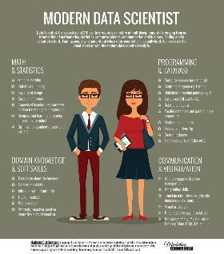
The data science recipe
Different ingredients needed
Data expert
Data processing, data structures
Data analyst
Data mining, statistics, machine learning
Visualization expert
Visual art design, storytelling skills
Domain expert
Provide understanding of the application domain
Business expert
Data driven decisions, new business models

Slide 16
Open issues
Social impact of analysis is very important
Interpretability and transparency of the analysis process
Bias in algorithms and data
Privacy preservation

Slide 17
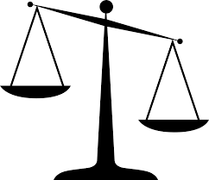
Interpretability in machine learning
“The ability to explain or to present in understandable terms to a human”
Trade-off Accuracy-Interpretability
Open the black box
Model explanation: global understanding of how a model works
Prediction explanation: local understanding of why a prediction is made

Slide 18
Interpretability
Learned decision rule in pneumonia patients dataset from USA hospital
history of asthma → lower chance of dying from pneumonia
MD consider asthma as a serious risk factor for people who get pneumonia
Analysis
asthmatics probably notice earlier the symptoms of pneumonia
a healthcare professional is going to provide earlier pneumonia diagnosis
as high-risk patients, they’re going to get high-quality treatment sooner than other people
asthmatics actually have almost half the chance of dying of non-asthmatics
Using a neural network, this model issue would never have been uncovered

Slide 19
Algorithmic and data bias
Task: predict likelihood of an individual committing a future crime
Risk scores used by US criminal justice system
Scores computed from
Questions answered by the defendants
Information pulled by criminal records
Race was not among the questions
… however other items may be correlated (e.g., poverty, joblessness)
Software product flagged black defendants as future criminals more frequently than white defendants
Training data was biased by a larger black defendant population

Slide 20
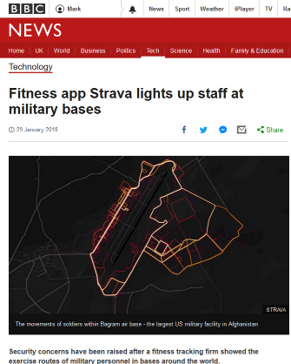
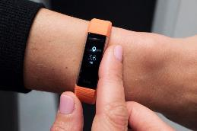
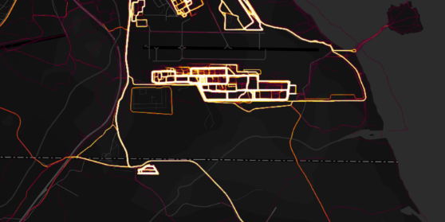
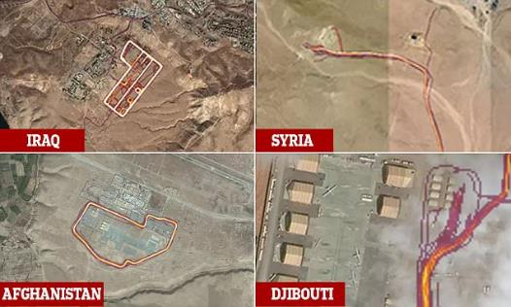
Privacy
Strava released their global heatmap. 13 trillion GPS points from their users

Slide 21
The database and data mining group
Tania Cerquitelli
Paolo Garza
Elena Baralis
Daniele Apiletti
Luca Cagliero
Silvia Chiusano
Giuseppe
Attanasio
Jacopo
Fior
Moreno
La Quatra
Eliana
Pastor
Elena
Daraio
Flavio
Giobergia
Andrea
Pasini
Francesco
Ventura
…. and many more!
Notes:
21

Slide 22
Thank you!

