Slide 1
Usare gli open-data per mappare l’efficienza energetica dei quardieri – il caso di EDISON
Tania CERQUITELLI
Department of Control and Computer engineering, Politecnico di Torino, Italy
Alfonso CAPOZZOLI (DENERG), Elena BARALIS (DAUIN), Marco MELLIA (DET)

Slide 2
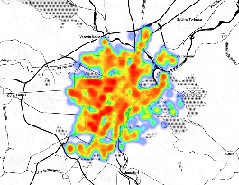
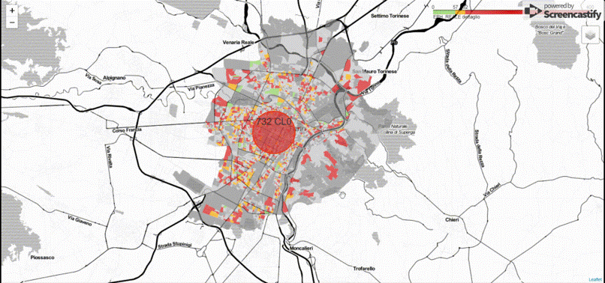
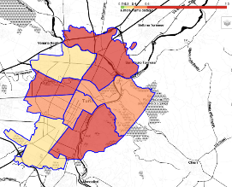
Main research objective
Characterization and
energy mapping, city of Turin
ENERGY DATA
OPEN DATA
Value for different stakeholders
Support and improve decisional processes

Slide 3
Main research objective
Values for the stakeholders
ENERGY DATA
OPEN DATA
Value for different stakeholders
Support and improve decisional processes
Create value from energy open data
Citizens
Public Administration
Energy companies
Estate agents
Mapping the energy demand of buildings at neighborhood and city level
Characterization of metropolitan areas with respect to energy-efficiency parameters
Targeted incentive policies
Energy planning
Development of more accurate benchmark models
Targeted promotional offers

Slide 4
Knowledge extraction process
Data
Selection
Preprocessing
Transformation
Knowledge extraction
Visualization interpretation

Slide 5
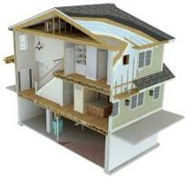
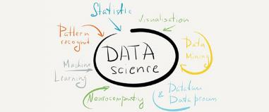
KDD from energy data: two key roles
DATA SCIENTIST
ENERGY SCIENTIST
Design innovative and efficient algorithms
Select the optimal techniques to address the challenges of the analysis
Identify the best trade-off between knowledge quality and execution time
Support the data pre-processing phase
Assess extracted knowledge
Strong involvement in the algorithm definition phase, which should respect/include physical laws and correctly model physical events

Slide 6
Knowledge extraction process
Data
Selection
Preprocessing
Transformation
Knowledge extraction
Visualization interpretation
Innovations in the data analytics process
Tailor the analytic steps to the different key aspects of energy data
Automate the data analytics workflow to reduce the manual user intervention
Translate the domain-expert knowledge into automated procedures
Generalize the extracted knowledge
Design informative dashboards to support the translation of the extracted knowledge into effective actions

Slide 7
Knowledge extraction process from EPCs
Data
Selection
Preprocessing
Transformation
Knowledge extraction
Visualization interpretation
Knowledge generalization

Slide 8
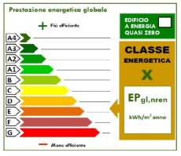
Open data: Energy Certificate of Buildings
Energy analysis of the building
Walling and window characteristics
Geometric features of the building
Hot water production
Environment cooling and heating
Type of plant
Renewable-energy production systems
Energy certificate officer
Qualified technicians granting APE certificates
Use of specific software (this information is not available in open data)
Building purchases
Lease agreements
Interventions to improve the building energy efficiency

Slide 9
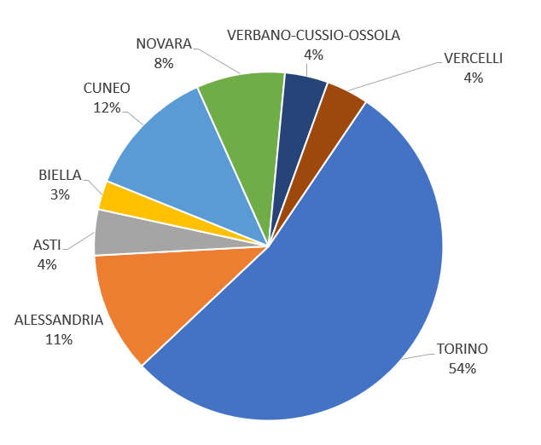
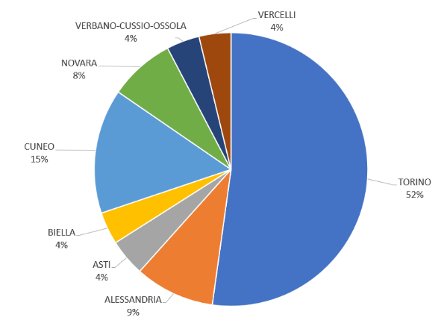
EPCs in Piedmont Region: 2 data sources
Distribution of the number of EPCs by province
Reference period 2009 – 2014
EPC no. 190,124
Reference period 2015 – 06/2018
EPC no. 78,733

Slide 10
Knowledge extraction process from EPCs
Data
Selection
Preprocessing
Transformation
Knowledge extraction
Visualization interpretation
Knowledge generalization

Slide 11
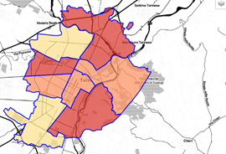
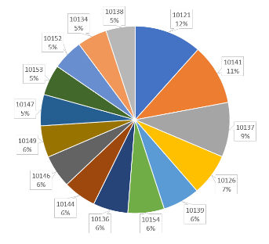
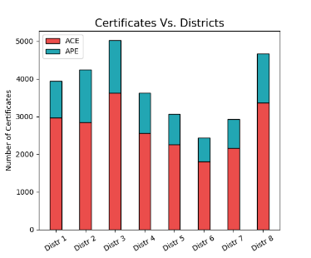
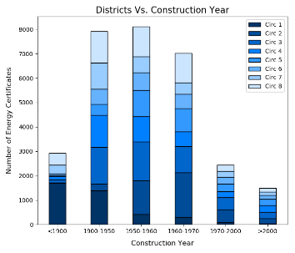
Cleaned dataset related to Turin
E1 (1) dwelling​s in Torino used as permanent residence
EPCs issued in the period: 2009 – 2018
EPCs for particella, foglio e subalterno (identifying each single dwelling)
Number of selected EPCs: 29,934
Percentage of EPCs with respect to the total building number in the ISTAT database: 29,934/600,000 ~ 5 %

Slide 12
Knowledge extraction process from EPCs
Data
Selection
Preprocessing
Transformation
Knowledge extraction
Visualization interpretation
Knowledge generalization

Slide 13
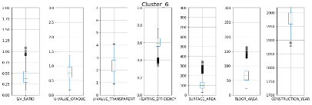
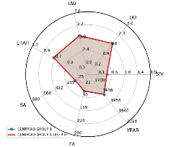
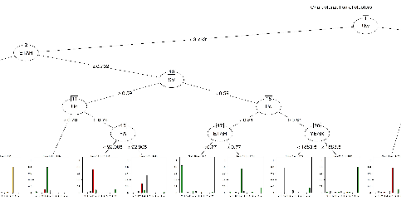
Cluster discovery and characterization
Identification of 12 relevant clusters of buildings through the analysis of EPCs
Each cluster of EPCs is characterized through:
Centroids represented through radar plots
Data distribution for each attribute modeled through boxplot
Cluster labels, assigned with the support of the domain expert
13

Slide 14
Cluster characterization
Cluster ID​ | EPC #​
Cluster 0 | 1,783
Cluster 1 | 1,810
Cluster 2 | 1,683
Cluster 3 | 857
Cluster 4 | 2,720
Cluster 5 | 1,450
Cluster 6 | 4,083
Cluster 7 | 3,574
Cluster 8 | 4,916
Cluster 9 | 3,725
Cluster 10 | 808
Cluster 11 | 2,525
 |  | Districts
 |  | 1 | 2 | 3 | 4 | 5 | 6 | 7 | 8
Cluster Label | 0 | 101 | 245 | 321 | 217 | 281 | 222 | 172 | 224
 | 1 | 231 | 289 | 311 | 249 | 131 | 137 | 145 | 317
 | 2 | 91 | 236 | 264 | 283 | 262 | 111 | 196 | 240
 | 3 | 251 | 54 | 92 | 79 | 23 | 42 | 109 | 207
 | 4 | 218 | 395 | 523 | 304 | 306 | 270 | 291 | 413
 | 5 | 430 | 185 | 234 | 165 | 33 | 37 | 105 | 261
 | 6 | 383 | 758 | 688 | 472 | 375 | 297 | 360 | 750
 | 7 | 419 | 433 | 637 | 480 | 415 | 325 | 351 | 514
 | 8 | 435 | 738 | 860 | 649 | 587 | 450 | 496 | 701
 | 9 | 480 | 591 | 643 | 472 | 351 | 274 | 359 | 555
 | 10 | 643 | 2 | 8 | 14 | 1 | 9 | 53 | 78
 | 11 | 255 | 321 | 440 | 245 | 300 | 268 | 292 | 404

Slide 15
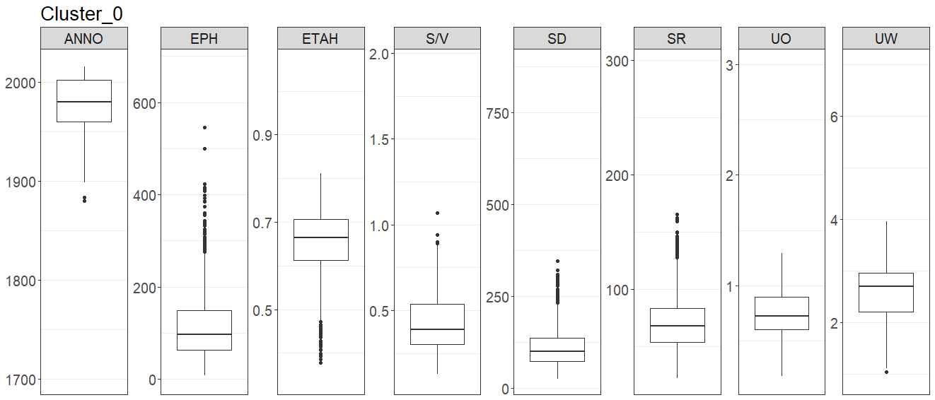
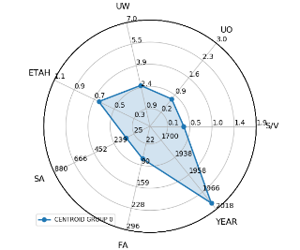
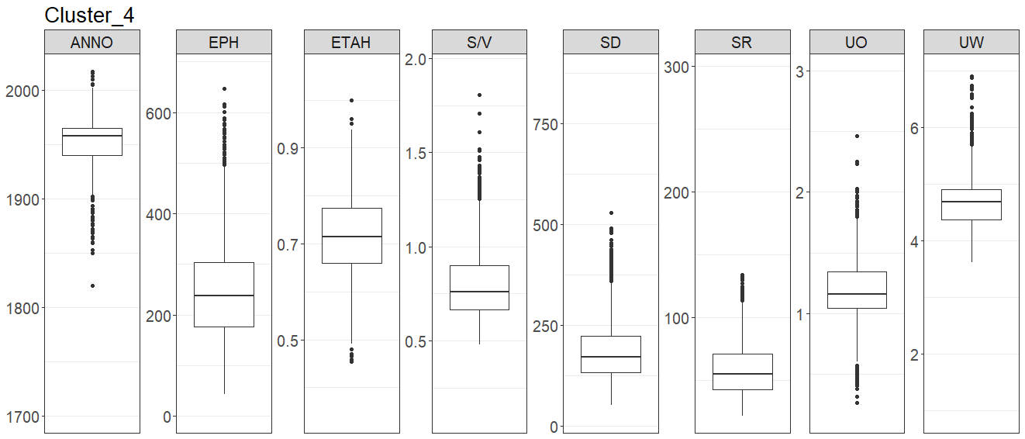
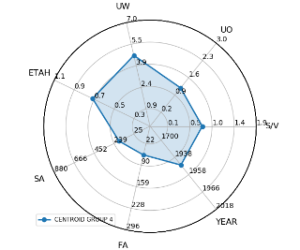
Clusters of EPCs: High vs Low energy performance

Slide 16
Semi-supervised data labeling
ClusterID | Energy Performance Label | Color | Description
0 | High |  | High performing envelope, medium performing energy system
1 | X |  | Low performing envelope, low values of SV
2 | High |  | High performing envelope and energy system
3 | X |  | Buildings with large surface area
4 | Low |  | Low performing envelope, high values of SV
5 | Medium |  | Low performing envelope, medium performing energy system, low values of SV
6 | High |  | Low performing envelope, high performing energy system, low values of SV
7 | Medium |  | High performing envelope, low performing energy system, low values of SV
8 | Medium |  | Medium performing envelope, low performing energy system, low values of SV
9 | High |  | Medium performing envelope, medium performing system, low values of SV
10 | X |  | Historical buildings
11 | Low |  | Medium performing envelope, medium performing system, high values of SV

Slide 17
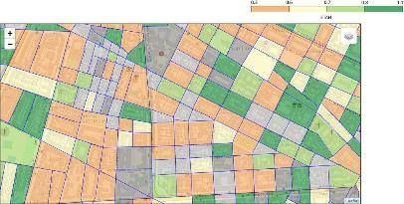
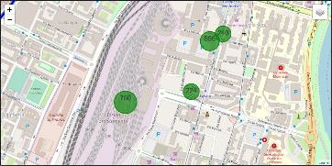
Knowledge visualization - DEMO
Maps with different spatial granularity levels
City
District
Neighborhood
Dwelling​s
Different types of maps
Choropleth maps
An aggregation metric is required
Majority model
Statistical functions to be defined with the domain expert
Scatter maps with individual markers
Maps with marker-clusters
Dynamic plots to model aggregated APEs

Slide 18
Knowledge extraction process from EPCs
Data
Selection
Preprocessing
Transformation
Knowledge extraction
Visualization interpretation
Knowledge generalization

Slide 19
Tania CERQUITELLI
… questions?

Slide 20
Public talks
Tania Cerquitelli Creare valore e strutturare conoscenza a partire da open data energetici: metodi, sfide e opportunità. Open Access Week @ POLITO, October 23th, 2018 Turin, Italy http://www.politocomunica.polito.it/news/allegato/(idnews)/11788/(ord)/0
Tania Cerquitelli Visualizing high-resolution exploratory energy maps by analyzing energy-performance certificates The 4th Workshop of the SmartData@PoliTO Interdepartmental Center will be held on February 28th, 2019 at Politecnico di Torino – AULA MAGNA https://smartdata.polito.it/4th-smartdata-workshop-public/#cerquitelli
Tania Cerquitelli and Alfonso Capozzoli Exploring open data to spread out knowledge: a real-world use
case in the energy domai. Focus on Open Access, Università di Torino, May 7th, 2019 Turin, Italy. http://www.politocomunica.polito.it/en/news/allegato/(idnews)/12677/(ord)/0

Slide 21
Joint publications
Cerquitelli T., Di Corso E., Proto S, Capozzoli A., Bellotti F., Cassese M.G., Baralis E., Mellia M., Casagrande S., Tamburini M., Exploring Energy Performance Certificates through Visualization. In Proceedings of the Workshops of the EDBT/ICDT 2019 Joint Conference (EDBT/ICDT 2019) Lisbon, Portugal, March 26, 2019.
Cerquitelli T., Di Corso E., Proto S, Capozzoli A., Mazzarelli D. M., Nasso A., Baralis E., Mellia M., Casagrande S., Tamburini M., Visualising high-resolution energy maps through the exploratory analysis of energy performance certificates. In Proceedings of the IEEE SEST 2019, Porto, Portugal, September 9-11, 2019.

